Slide 2
Transition function:

Slide 3
Transition function:

Slide 4
Formal Definition
Pushdown Automaton (PDA)
Accept
states
States
Input
alphabet
Stack
start
symbol
Transition
function
Initial
state
Stack
alphabet

Slide 5
Instantaneous Description
Current
state
Current
stack
contents
Remaining
input

Slide 6
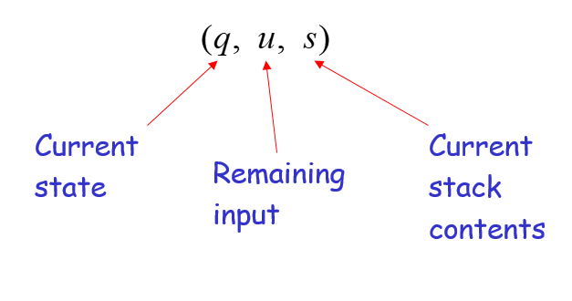
Example:
Instantaneous Description
Time 4:
Input
Stack

Slide 7
Example:
Instantaneous Description
Time 5:
Input
Stack

Slide 8
We write:
Time 4
Time 5

Slide 9
A computation:

Slide 10
For convenience we write:

Slide 11
Language of PDA
Language accepted by PDA :
Initial state
Accept state

Slide 13
PDAs Accept Context-Free Languages

Slide 14
Properties of Context-Free languages

Slide 15
Positive Closure for CFL

Slide 16
Union
Context-free languages
are closed under:
Union
is context free
is context free
is context-free

Slide 17
Example
Language
Grammar
Union

Slide 18
In general:
For context-free languages
with context-free grammars
and start variables
The grammar of the union
has new start variable
and additional production

Slide 19
Concatenation
Context-free languages
are closed under:
Concatenation
is context free
is context free
is context-free

Slide 20
Example
Language
Grammar
Concatenation

Slide 21
In general:
For context-free languages
with context-free grammars
and start variables
The grammar of the concatenation
has new start variable
and additional production

Slide 22
Star Operation
Context-free languages
are closed under:
Star-operation
is context free
is context-free

Slide 23
Example
Language
Grammar
Star Operation

Slide 24
In general:
For context-free language
with context-free grammar
and start variable
The grammar of the star operation
has new start variable
and additional production

Slide 25
Negative Closure for CFL

Slide 26
Intersection
Context-free languages
are not closed under:
intersection
is context free
is context free
not necessarily
context-free

Slide 27
Example
Context-free:
Context-free:
Intersection
NOT context-free

Slide 28
Complement
Context-free languages
are not closed under:
complement
is context free
not necessarily
context-free

Slide 29
Example
Context-free:
Context-free:
Complement
NOT context-free

Slide 30
Intersection of Context-free languages and Regular Languages

Slide 31
The intersection of
a context-free language and
a regular language
is a context-free language
context free
regular
context-free

